Slide 1

CTP
MINI PROJECT
ENDSEM LAB ASSIGNMENT

Slide 2

TITLE
COVID ASSISTANT - ^{A MINI C PROJECT}

Slide 3
PROBLEM STATEMENT
& DESCRIPTION
The sudden spread of the Covid-19 virus was a startling and distressing phase of everyone's life. It had been ages since the world had last witnessed such a disastrous pandemic. With an outburst in the number of active cases and a steep increase in death rate, it had become really important to suppress the calamity. The lockdown acted as a temporary solution to the problem but did not prove to be completely effective as it had its own drawbacks - majorly being the large impact on local economies and government budgets. Then, soon later, Covid-
19 vaccines were released which brought back hope into people's lives. Having limited supplies of the vaccines, the government had to not only make sure of conveniently making it reach to the huge mass of people but also take care of its black marketing. To assure the proper and the legal usage of vaccinations, we came up with the 'Covid Assistant' program which would help the vaccination campaign to run smoothly and effectively.s.

Slide 4


MOvED BY maNY PROBLEmS THaT wE HavE COmE TO LIGHT RECENTLY RELaTED TO COvID vaCCINaTION, wE DECIDED TO maKE a SmaLL PROGRam THaT CaN HELP aND maNaGE vaCCINES FROm THE FaCTORY TO THE FRONT LINE wITH SPEED SCaLE aND FLEXIBILITY.OUR PROGRamS wILL HELP CITIZENS TO REmOvE OBSTaCLES TO QUICKLY GET vaCCINES wITH NEw PLaTFORm CONNECT wORKFLOwS aCROSS SYSTEmS FOR EFFECTIvE vaCCINE DISTRIBUTION aND mONITORING. THE COmPLaINTS THaT GOvERNmENT FaCE OF LImITED vaCCINE SUPPLY mOTIvaTED US TO maKE a PROGRam wHEREIN PEOPLE GET THE SUPPLIES aT RIGHT TImE

Slide 5

SOLUTION
THE COVID MANAGEMENT PROGRAM
We've brainstormed a series of ideas for the Covid-19 management program and have focussed on the user experience as you interact with the program at a time full of uncertainty, emotions, and anxiety. In this program, we target to build a covid manager that has basic functionalities such as patient checks and vaccination calendars using C language. This uses wide areas of C such as file management ( database ) to store info of vaccination centers, Questionnaire to understand the patient condition and giving health suggestions, emergency contact details, and a terminal interface for the users to interact with

Slide 6
PROGRAM SUMMARY
01
02
Functions :
getData() - to get patient info
setData() - process & store data
DoctorInfo() - get Doctor details
DoctorStats() - check Doctor status
checkmyHealth() - patient checkup
Storing Data :
File Management
Array of struct
Dynamic array using calloc()
03
Control Structures :
Conditionals - if, if-else if-else, switch
Iterations - for loop, while loop

Slide 7
RESULTS
1. Patients
The code stores and retrieves patient details on registration and login respectively
Registration :
Display the form for filling the basic information for the of patients entered using basic form checks and validation, Uses basic file management using c to push file into a csv file. uses a separate csv file to store passwords
Login :
Enters the patient ID and password to login
Detail view
Retrieve data of the logged in patient and displays it in a well arranged tabular form
Add Issue :
A tab to manage and organize the issue of the patient and related symptoms
Summary :
To view and report latest details of a patient issue and resolve

Slide 8
RESULTS
2. Doctor
The code stores and retrieves patient details on registration and login respectively,
Uses basic file management using c to push file
Enter New Doctor Table
Doctor Name:
Doctor ID:
Doctor Age:
Gender:
Time Hour And Minutes , AM/PM:
For one Doctor time table
Remove Doctor Time Table

Slide 9
RESULTS
3. Covid Stats
The code is responsible for storing and retrieving information for COVID statistics.
It pushes files into a CSV file using basic file management techniques implemented in C.
It displays the number of COVID patients from each state in descending order, with the state with the greatest number of patients at the top of the list, as well as the total number of deaths.

Slide 10
RESULTS
4. Health Checker
The code asks the user if they are suffering from any covid symptoms or if they have any pre-existing conditions. Considering the health issues and the recent travel records of the user, Health Checker will help in calculating the risk of being affected by the Corona Virus.
Questions regarding Covid symptons
Questions regarding Pre-existing conditions
Recent Travel Details
Risk Percentage
Message for the user (based on the Risk Percentage)

Slide 11

CONCLUSION
In conclusion, the project aims to provide a working interface to manage the covid patients and we have covered code for storing data, accessing data, processing data, and publishing data using different data structures and file management methods. The code is also filled with different control structures and covers a good extent of the C language Learning outcomes - It was important to us that we learned how to design a program architecture, convert real-life situations into efficient code, how we can write readable and understandable code that is both time- and memory- efficient, wise usage of file management and other
storage structures.

Slide 12
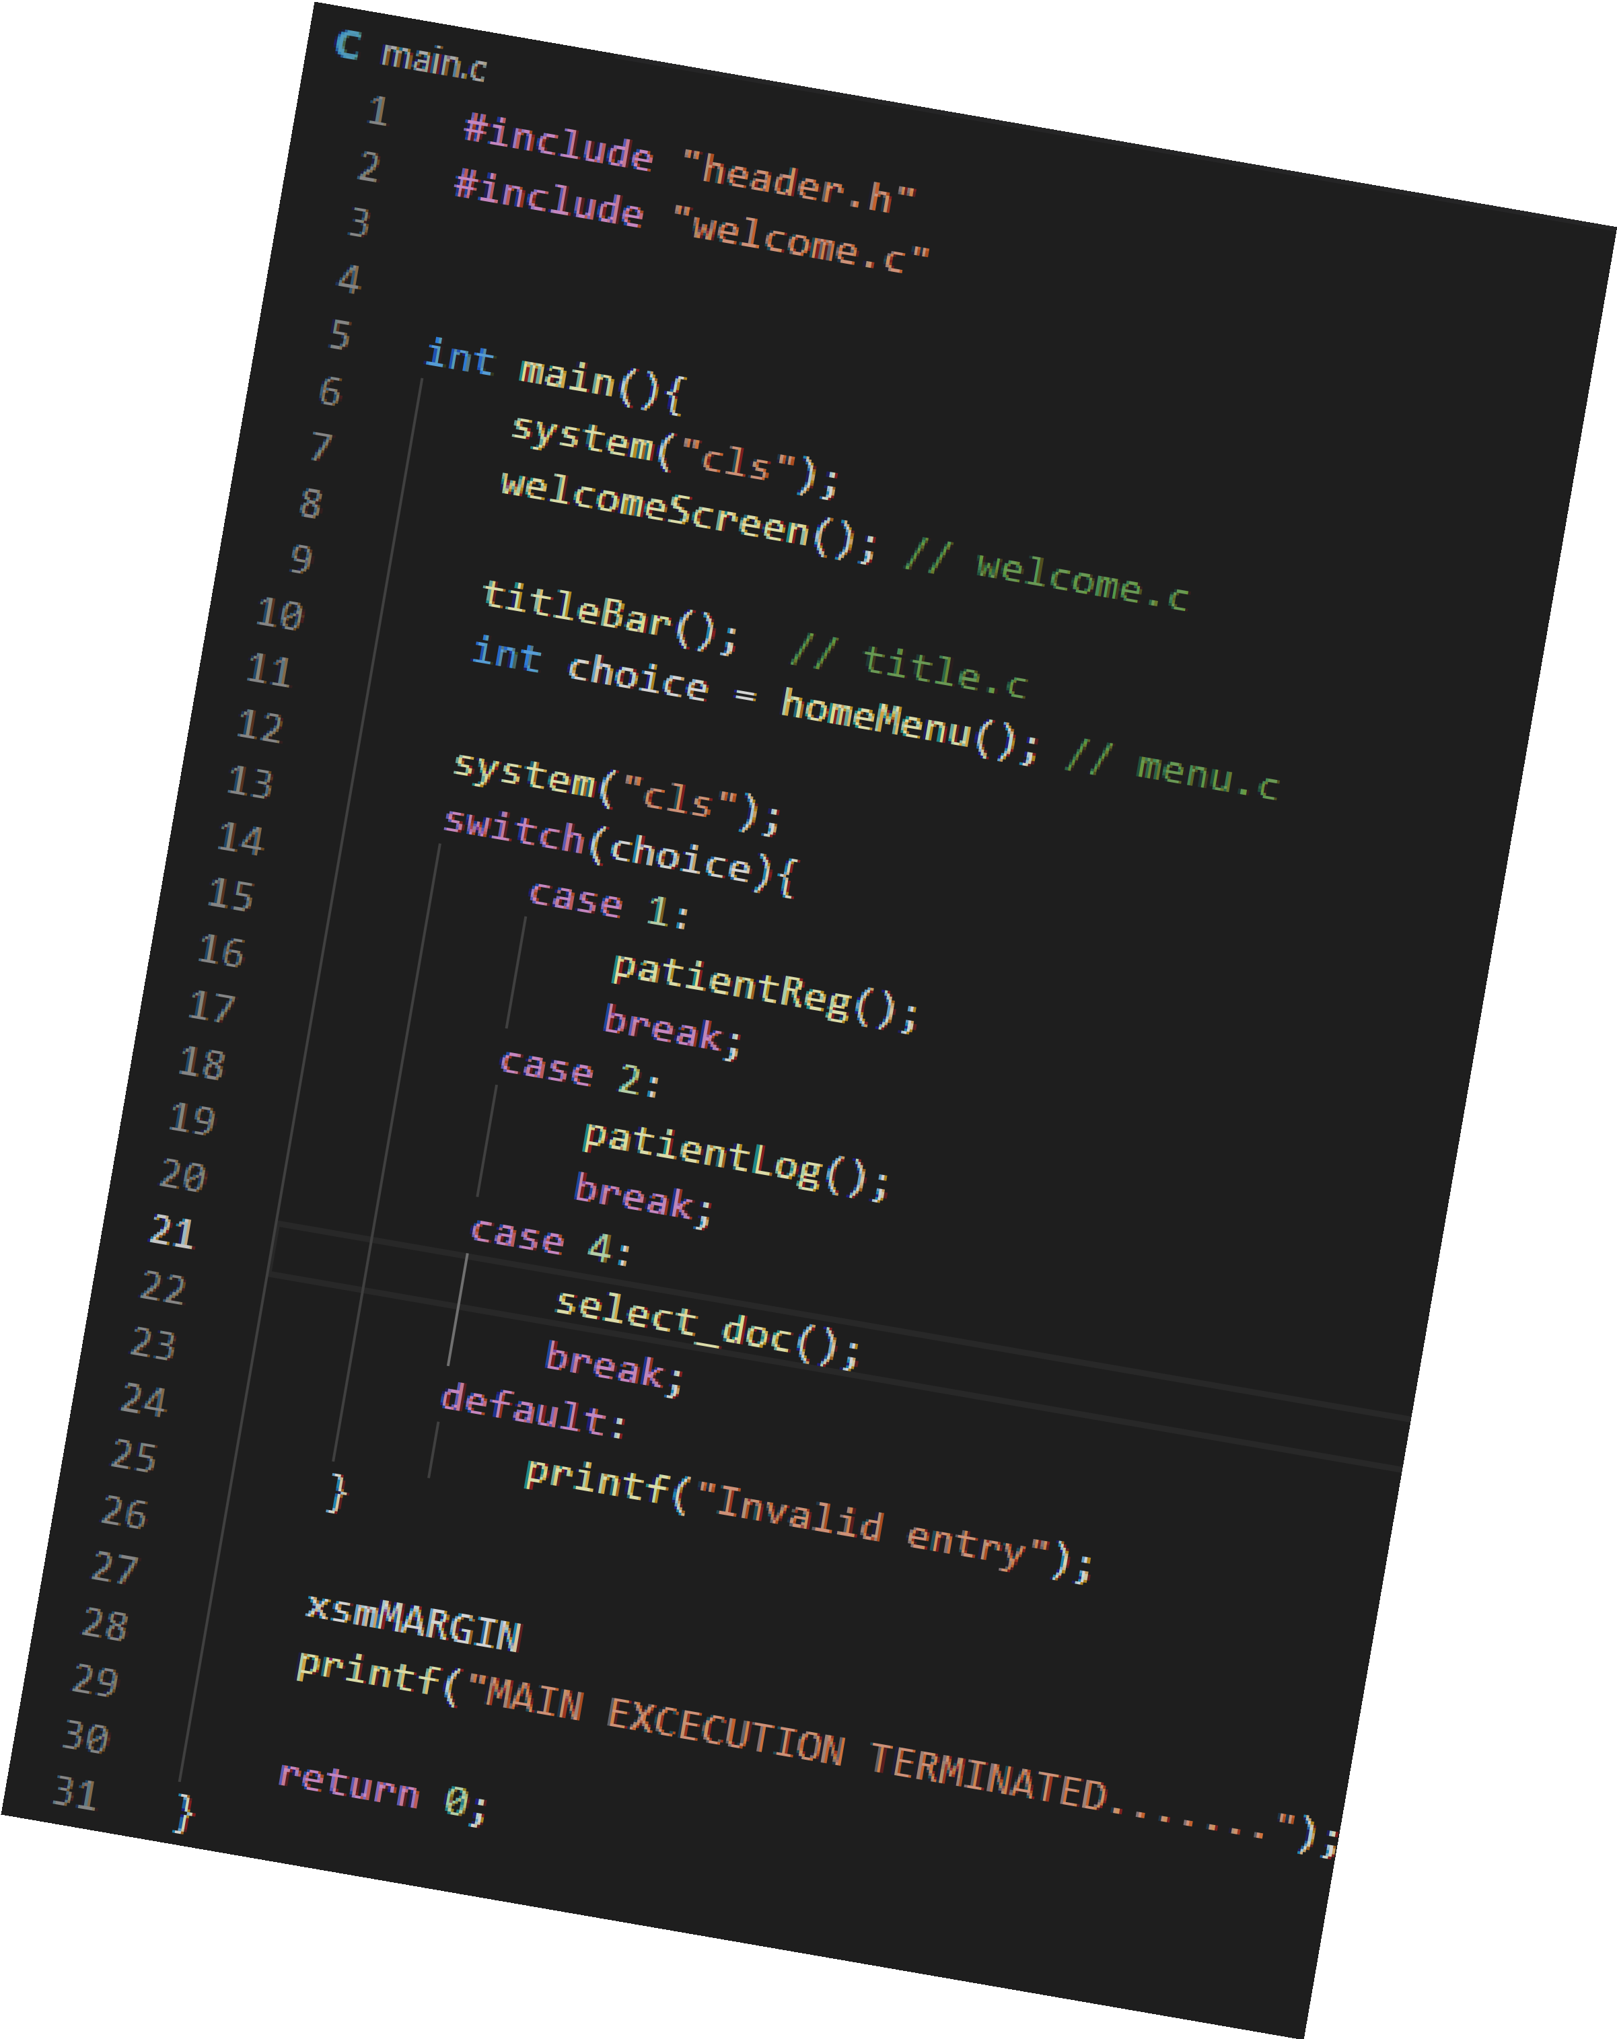
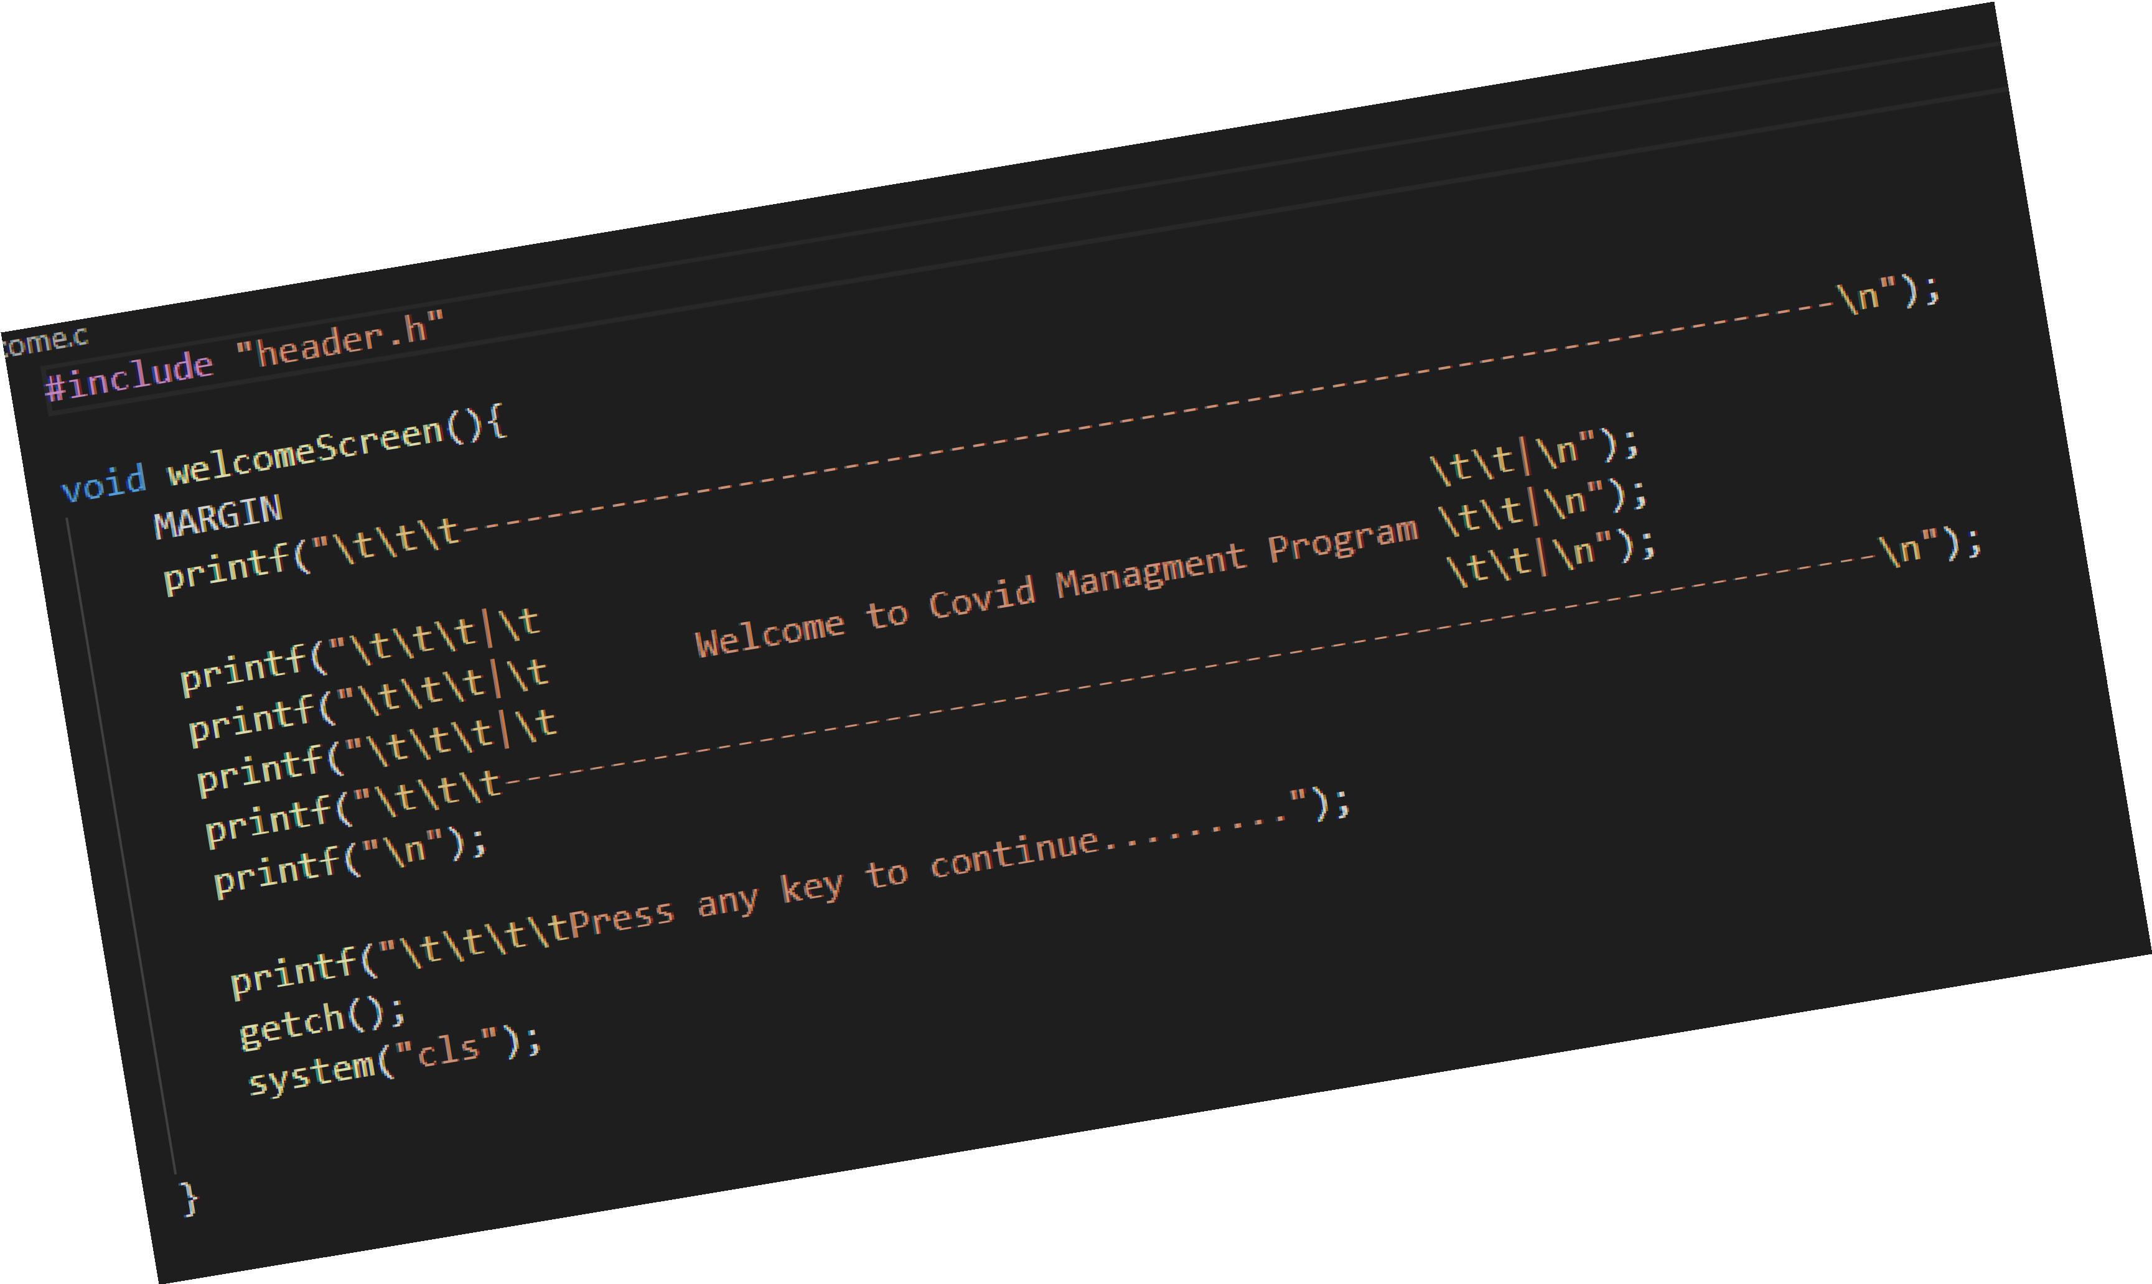
APPENDEX
Code Screenshots

Slide 13
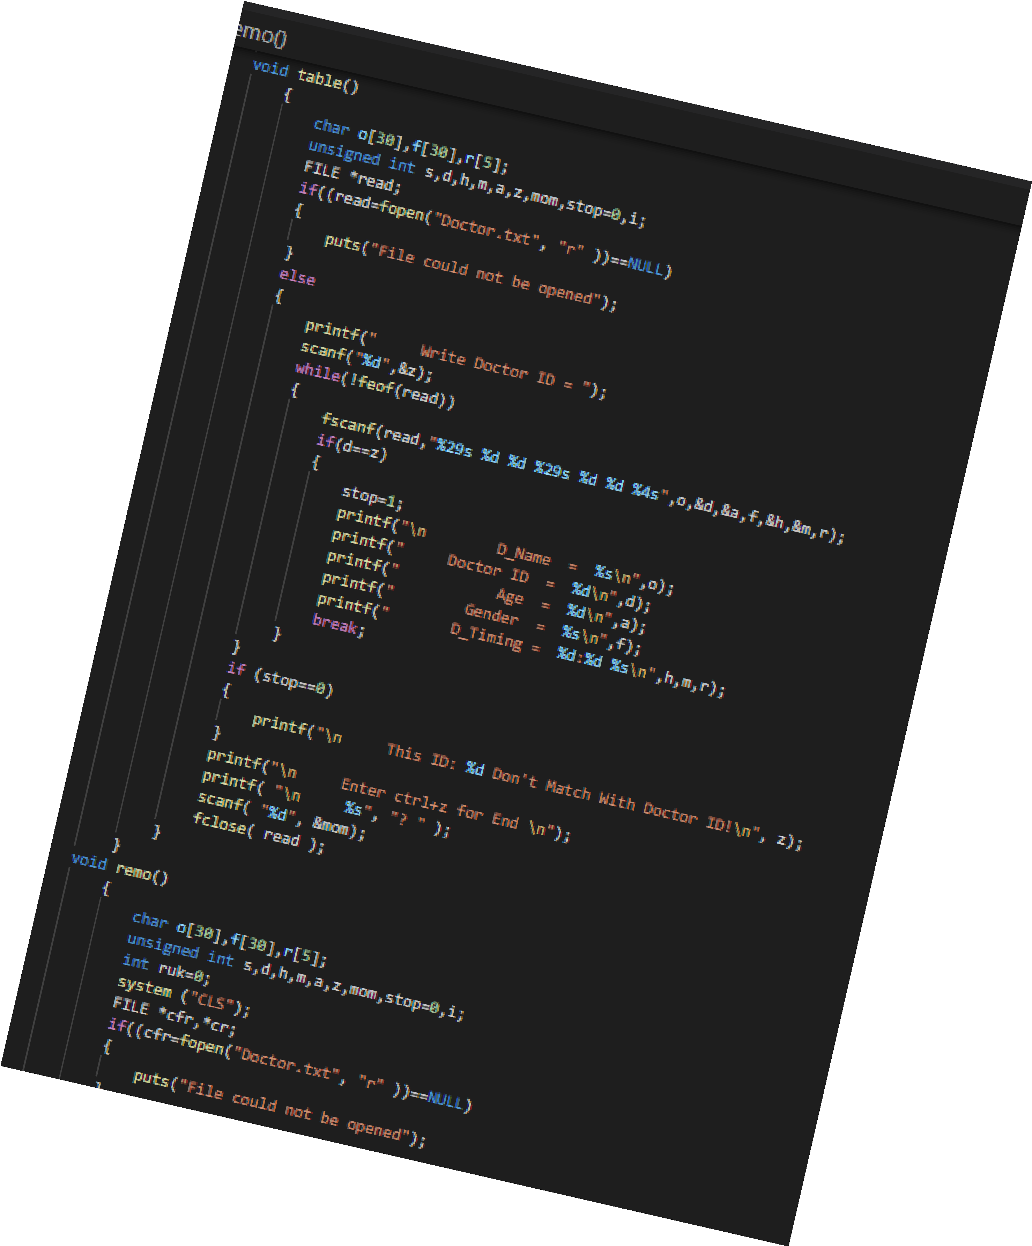
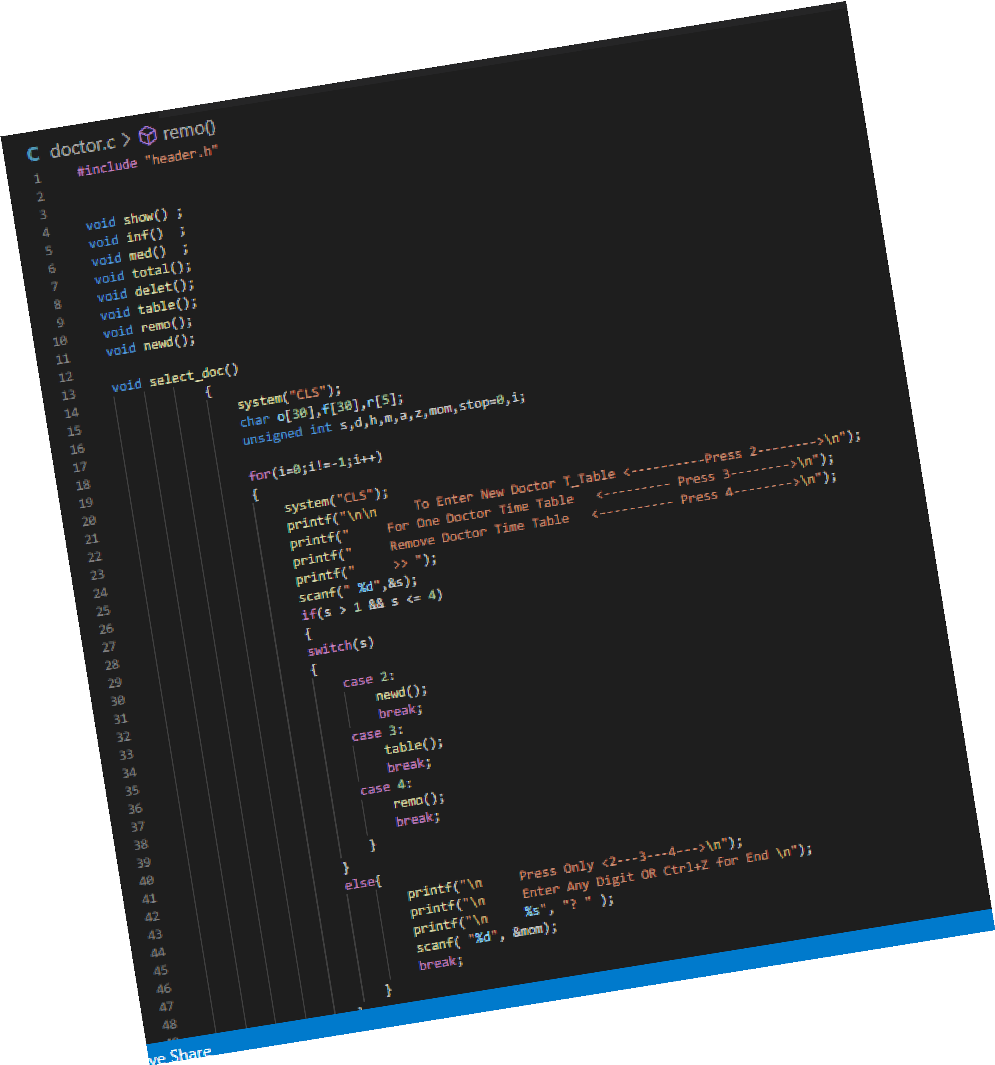
APPENDEX
Code Screenshots

Slide 14
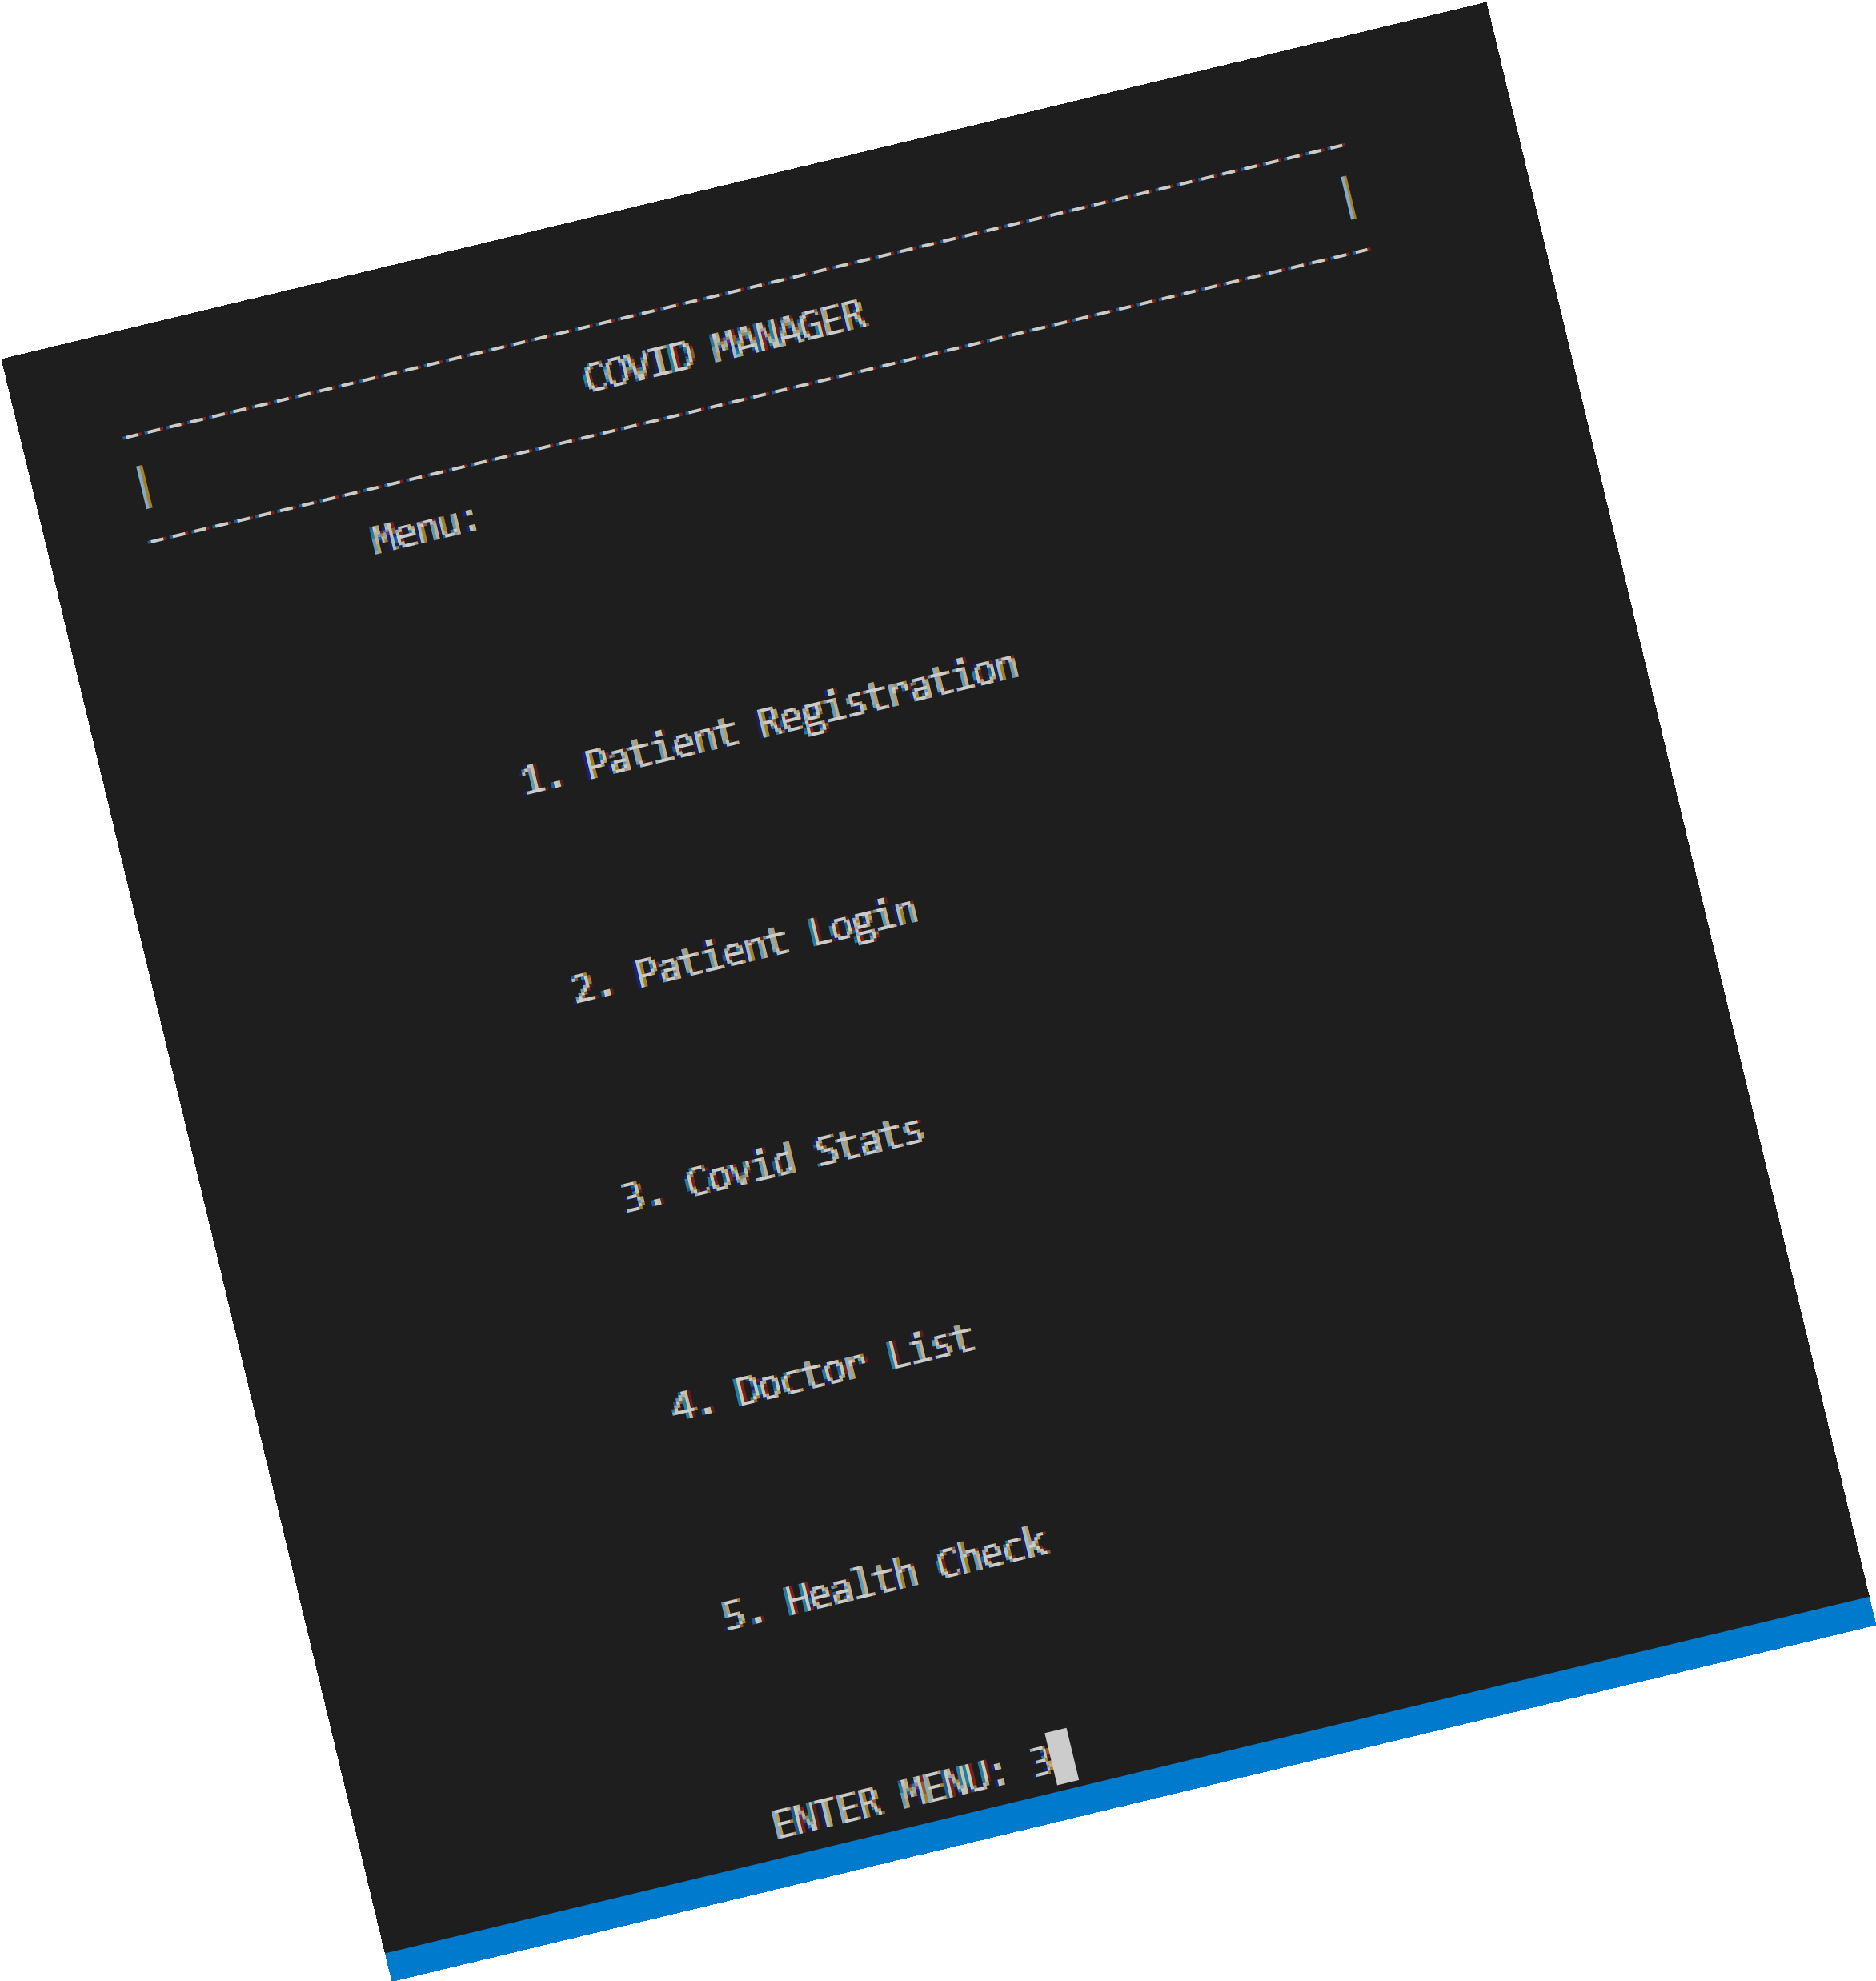
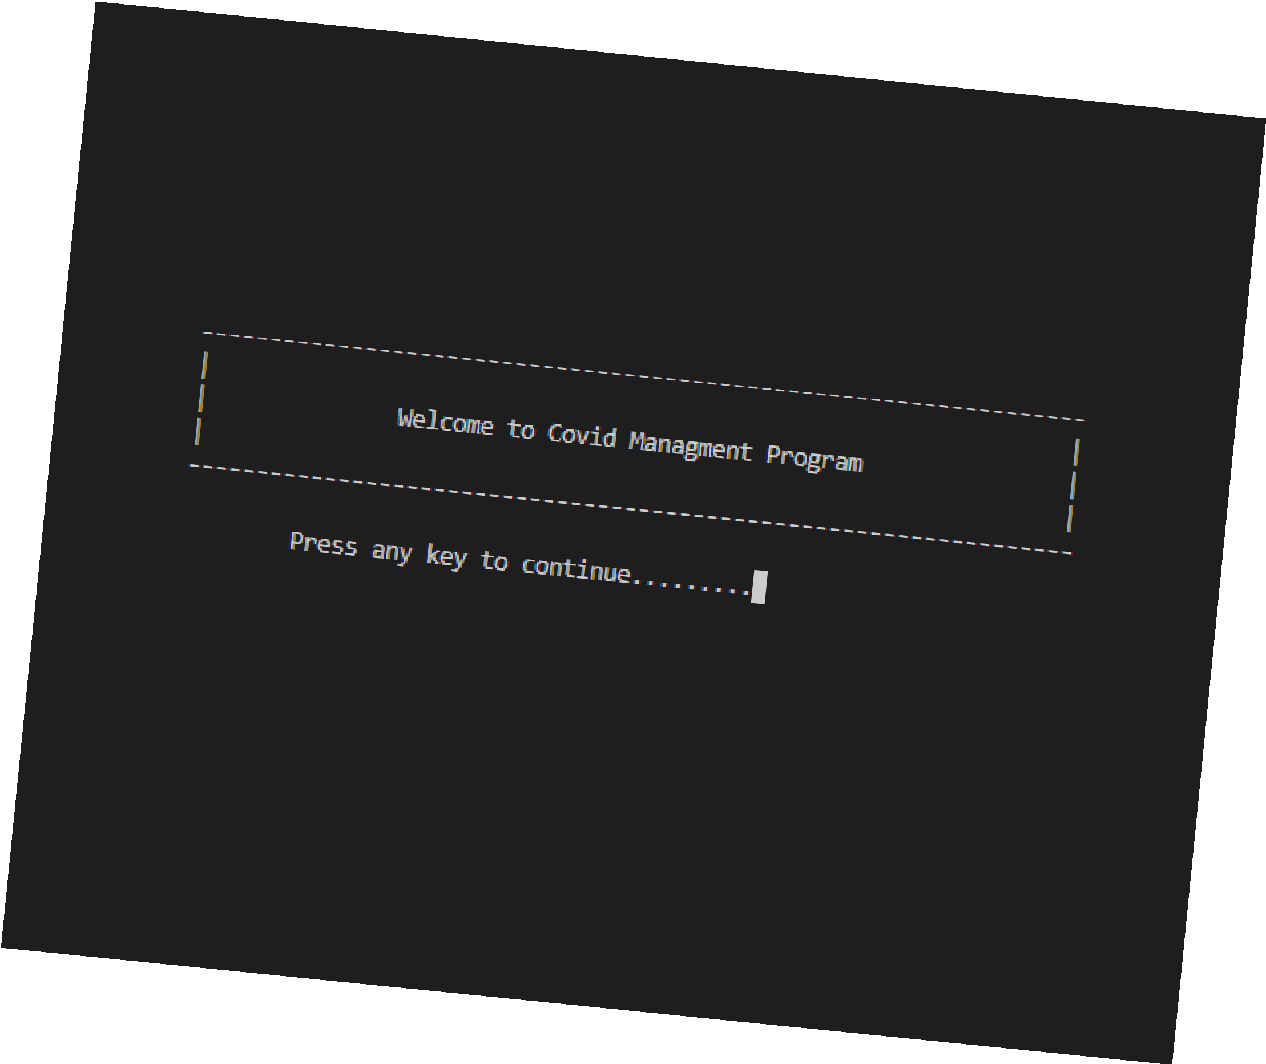
APPENDEX
Output Screenshots

Slide 15
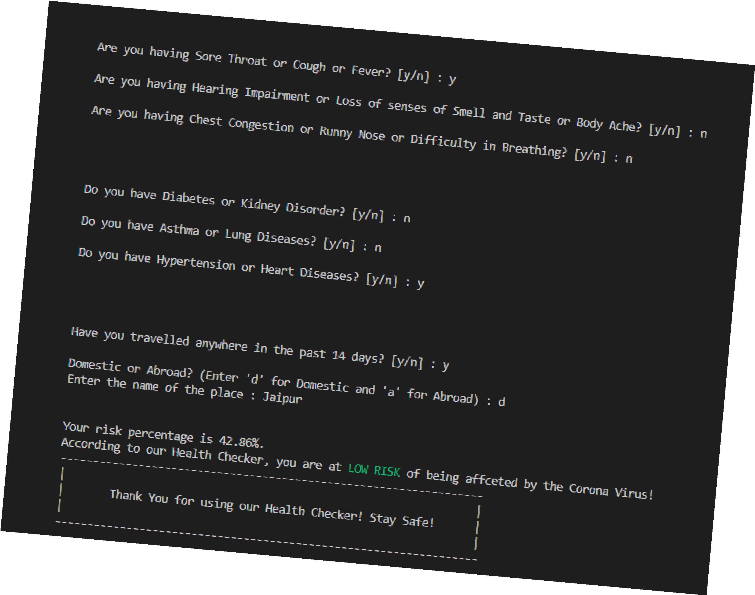
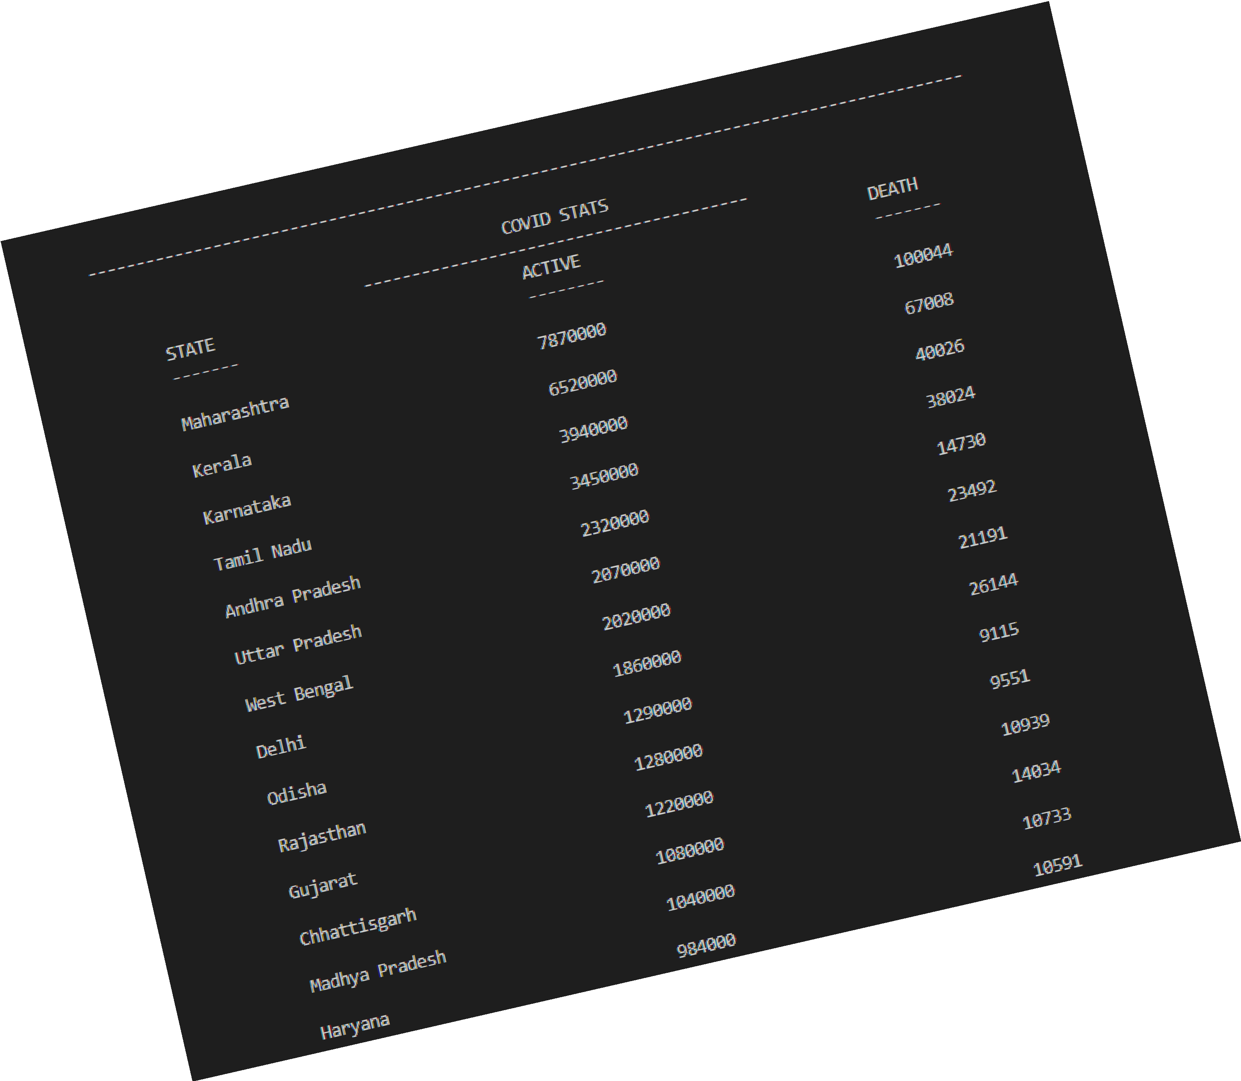
APPENDEX
Output Screenshots

Slide 16

APPENDEX
CTP Mini project Github link: click here

Slide 17







